Slide 1
Chapter 1
Information Systems and Managerial Decision-Making Systems
Dr. Ahmed aboul-fotouh
IS . Dept.
2-<number>

Slide 2
Information Systems and the functions of Management
Planning
Organizing
Directing
Controlling
Decision making

Slide 3
What Managers Do
Managerial Functions (Managers do the following):
  Plan what they are to do
  Organize to meet the plan
  Staff their organization with resources
  Direct them to execute the plan
  Control the resources, keeping them on course (see Figure 1.13)

Slide 4
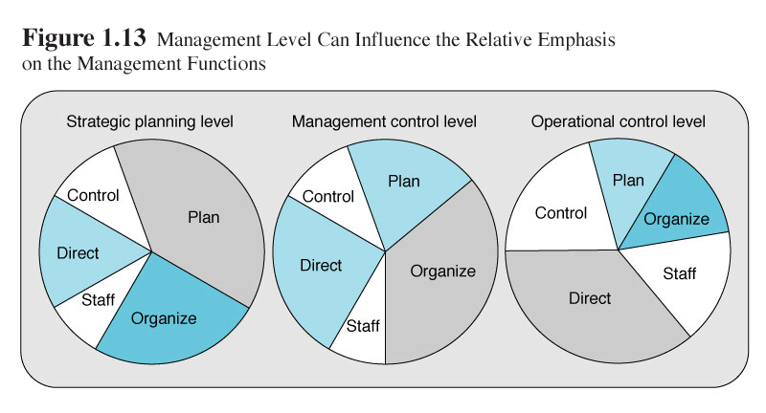

Slide 5
MANAGERS AS INFORMATION SYSTEM USERS
Managers exist يتواجدون at various managerial levels and within various business areas of the firm
What level an IS is developed for influences من اجل التأثير علىhow it operates (see Figure 1.1)
The 3 primary management levels are (see Figure 1.2):
      Strategic planning level
      Management control level
      Operational control level

Slide 6
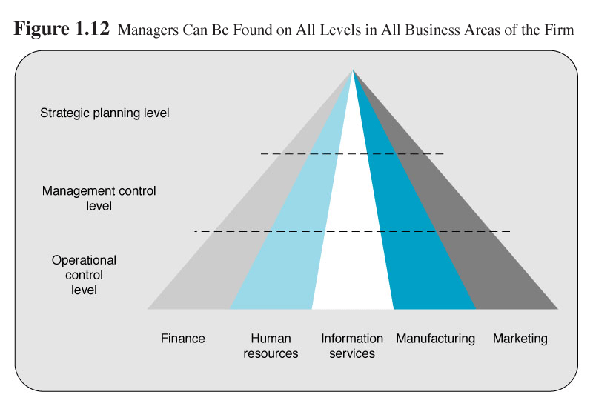

Slide 7
Strategic Management
Monitor the strategic performance of the organization and its overall direction in the political, economic, and competitive business environment
Unstructured Decisions
  Not possible to specify in advance most of the decision procedures to follow
  Decision maker must provide judgement, evaluation and insights to a novel, important and nonroutine-type decision
Require more summarized, ad hoc, unscheduled reports, forecasts, and external intelligence to support their more unstructured planning and policy-making responsibilities

Slide 8
Tactical Management
Allocate resources and monitor the performance of their organizational subunits, including departments, divisions, process teams, and other workgroups
Semistructured Decisions
  Some decision procedures can be prespecified, but not enough to lead to a definite recommended decision
  Only part of the decision has a clear-cut answer provided by an accepted procedure
Require information from both the operational level and the strategic level to support their semistructured decision making responsibilities

Slide 9
Operational Management
Direct the use of resources and the performance of tasks according to procedures and established budgets and schedules
Structured Decisions
  The procedures to follow when a decision is needed can be specified in advance
  Involves a repetitive and routine-type decision where there is a definite procedure to follow
Require more prespecified internal reports emphasizing detailed current and historical data comparisons that support day-to-day operations

Slide 10
THE BUSINESS ORGANIZATION
Information systems have been developed to support all organizational levels (see Figure)
At the strategic level, executive information systems are used by the firm's top managers
An MIS is designed to meet the information needs of managers throughout the firm
At the lowest, operational level systems are designed to meet the firm’s day-to-day information needs in those business areas

Slide 11
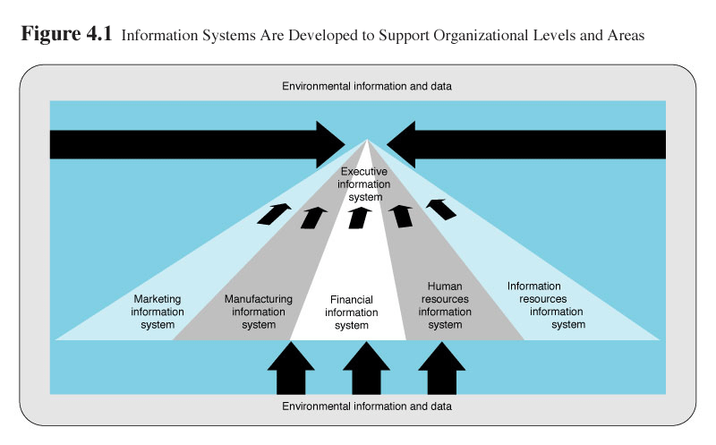

Slide 12
Decision Making &
Problem Solving

Slide 13
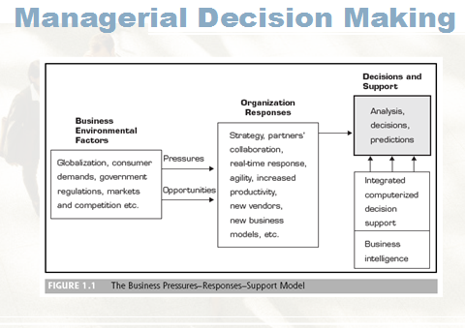
2-<number>

Slide 14
Decision Making
Process of choosing amongst alternative courses of action for the purpose of attaining a goal or goals.
2-<number>

Slide 15
Types of Decision
  Structured decisions, by contrast, are repetitive and routine, and decision makers can follow a definite procedure for handling them to be efficient.
  semistructured decisions, in which only part of the problem has a clear-cut answer provided by an accepted procedure.
  unstructured decision making is more common at higher levels of the firm.
2-<number>

Slide 16
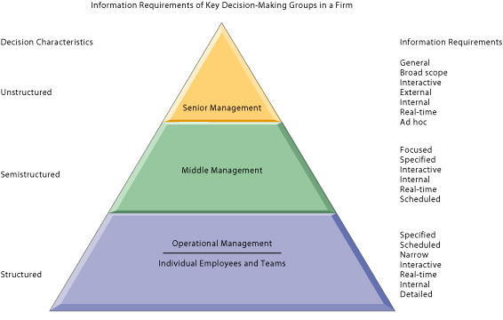
Types of Decsison
2-<number>

Slide 17
Decision Support Frameworks
 | Type of Control
Type of Decision: | Operational Control | Managerial Control | Strategic Planning
Structured (Programmed) | Accounts receivable, accounts payable, order entry | Budget analysis, short-term forecasting, personnel reports | Investments, warehouse locations, distribution centers
Semistructured | Production scheduling, inventory control | Credit evaluation, budget preparation, project scheduling, rewards systems | Mergers and acquisitions, new product planning, compensation, QA, HR policy planning
Unstructured (Unprogrammed) | Buying software, approving loans, help desk | Negotiations, recruitment, hardware purchasing | R&D planning, technology development, social responsibility plans
© 2005 Prentice Hall, Decision Support Systems and Intelligent Systems, 7th Edition, Turban, Aronson, and Liang
1-<number>

Slide 18
Decision Support Technologies
Management Information Systems (MIS)
Decision Support Systems (DSS)
Enterprise (Executive) Information Systems (EIS)
Enterprise Resource Planning (ERP) and Supply-Chain Management (SCM)
Knowledge Management Systems
Expert Systems (ES)
Artificial Neural Networks (ANN)

Slide 19
Technologies for Decision-Making Processes
Type of Decision | Technology Support Needed
Structured (Programmed) | MIS, Management Science Models, Transaction Processing
Semistructured | DSS, KMS, GSS, CRM, SCM
Unstructured (Unprogrammed) | GSS, KMS, ES, Neural networks
© 2005 Prentice Hall, Decision Support Systems and Intelligent Systems, 7th Edition, Turban, Aronson, and Liang
1-<number>

Slide 20
The systems approach to problem solving
Define the problem
  Define a problem or opportunity in a system context.
  Develop and evaluate alternative system solutions
  Select the system solution that best meets your requirements.
Design the selected solution to meet your requirements.
Implement and evaluate the success of the designed system.
Develop Alternative Solutions
Select the solution
Design the selected solution
Implementation the solution

Slide 21
The process of decision making
  Defining the problem (a decision situation that may deal with some difficulty or with an opportunity)
  Constructing a model that describes the real-world problem
  Identifying possible solutions to the modeled problem and evaluating the solutions
  Comparing, choosing, and recommending a potential solution to the problem
2-<number>

Slide 22
Phases of Decision-Making Process
Simon’s original three phases:
  Intelligence
  Design
  Choice
He added fourth phase later:
  Implementation
Book adds fifth stage:
  Monitoring
© 2005 Prentice Hall, Decision Support Systems and Intelligent Systems, 7th Edition, Turban, Aronson, and Liang
2-<number>

Slide 23
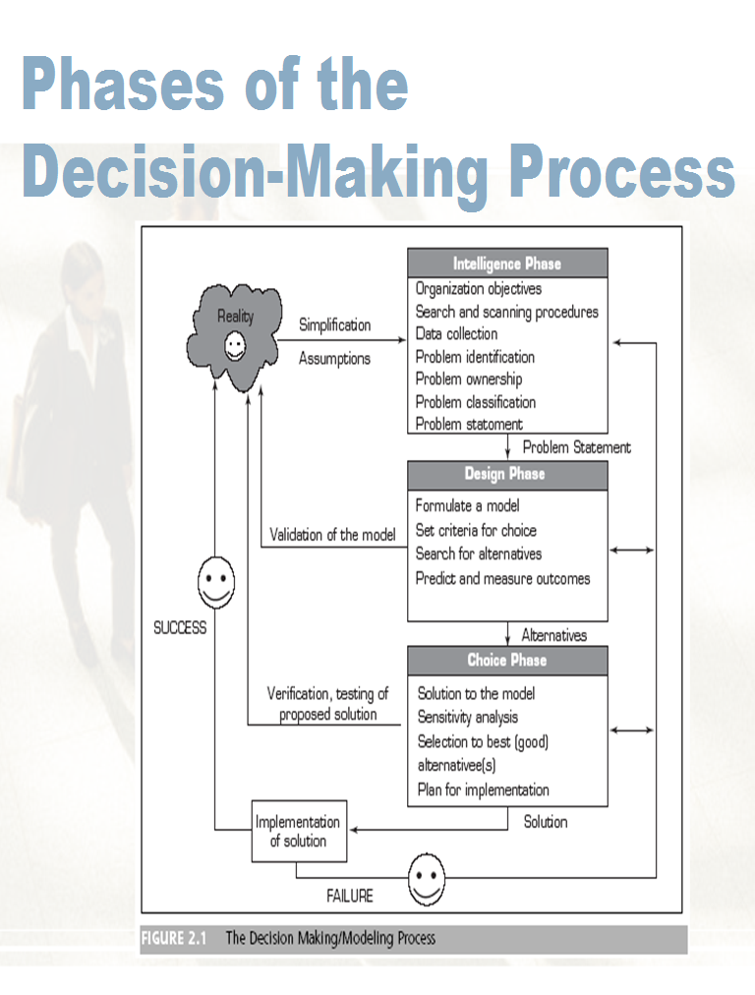
2-<number>

Slide 24
The Intelligence Phase
Decision maker examines the organization’s environment for conditions that need decisions
Data is collected from a variety of sources and processed
Decision maker can discover ways to approach the problem

Slide 25
Decision-Making Intelligence Phase
Scan the environment
Analyze organizational goals
Collect data
Identify problem
Categorize problem
  Programmed and non-programmed
  Decomposed into smaller parts
Assess ownership and responsibility for problem resolution
2-<number>

Slide 26
The Intelligence Phase (cont’d.)
Three parts
  First: determine what the reality is
  Second: get a better understanding of the problem by collecting data and information about it
  Third: gather data and information needed to define alternatives for solving the problem

Slide 27
The Design Phase
Objective
  Define criteria for the decision
  Generate alternatives for meeting the criteria
  Define associations between the criteria and the alternatives
Defining associations between alternatives and criteria involves understanding how each alternative affects the criteria
Information technology doesn’t support this phase of decision making much

Slide 28
The Choice Phase
Best and most effective course of action is chosen
  From the practical alternatives
Analyze each alternative and its relationship to the criteria to determine whether it’s feasible
Decision support system (DSS) can be particularly useful in this phase

Slide 29
The Implementation Phase
Organization devises a plan for carrying out the alternative selected in the choice phase
Obtains the resources to implement the plan
DSS can do a follow-up assessment on how well a solution is performing

Slide 30
Decision-Making Implementation Phase
Putting solution to work
  Dealing with resistance to change
  User training
  Upper management support
2-<number>

Slide 31
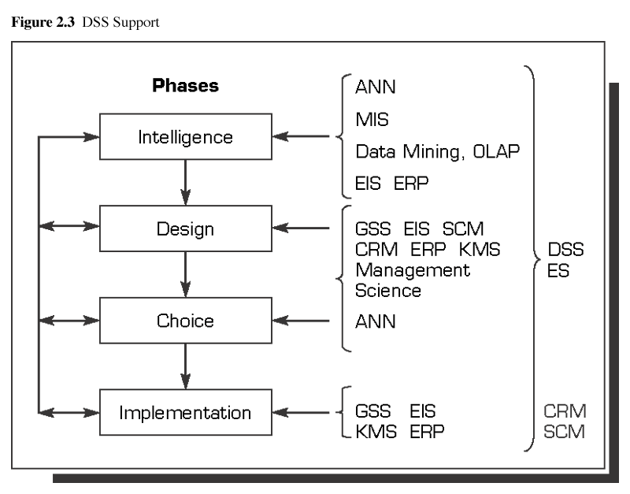
Source: Based on Sprague, R.H., Jr., “A Framework for the Development of DSS.” MIS Quarterly, Dec. 1980, Fig. 5, p. 13.
© 2005 Prentice Hall, Decision Support Systems and Intelligent Systems, 7th Edition, Turban, Aronson, and Liang
2-<number>

Slide 32
How Decisions are supported in the different phases
Intelligence Phase
  Automatic
    Data Mining
      Expert systems, CRM, neural networks
  Manual
    OLAP
    KMS
  Reporting
    Routine and ad hoc
© 2005 Prentice Hall, Decision Support Systems and Intelligent Systems, 7th Edition, Turban, Aronson, and Liang
2-<number>

Slide 33
How Decisions are supported
Design Phase
  Financial and forecasting models
  Generation of alternatives by expert system
  Relationship identification through OLAP and data mining
  Recognition through KMS
  Business process models from CRM, RMS, ERP, and SCM
© 2005 Prentice Hall, Decision Support Systems and Intelligent Systems, 7th Edition, Turban, Aronson, and Liang
2-<number>

Slide 34
How Decisions are supported
Choice Phase
  Identification of best alternative
  Identification of good enough alternative
  What-if analysis
  Goal-seeking analysis
  May use KMS, GSS, CRM, ERP, and SCM systems
© 2005 Prentice Hall, Decision Support Systems and Intelligent Systems, 7th Edition, Turban, Aronson, and Liang
2-<number>

Slide 35
How Decisions are supported
Implementation Phase
  Improved communications
  Collaboration
  Training
  Supported by KMS, expert systems, GSS
© 2005 Prentice Hall, Decision Support Systems and Intelligent Systems, 7th Edition, Turban, Aronson, and Liang
2-<number>

